Slide 1
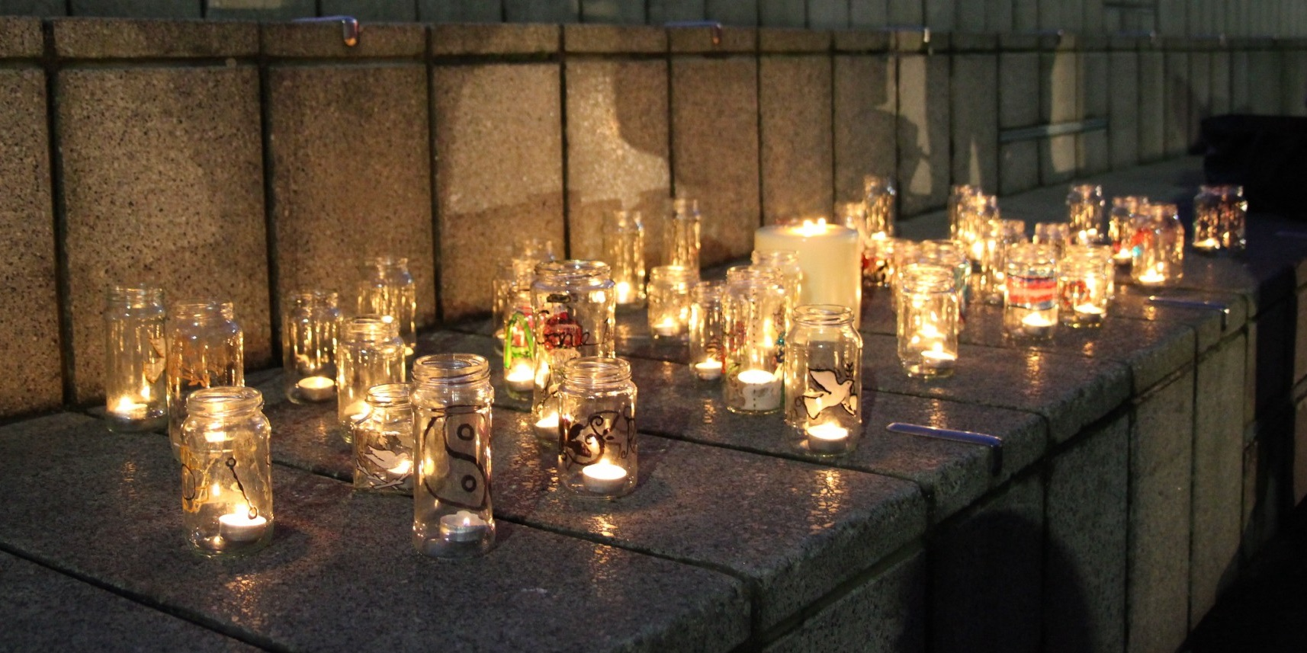
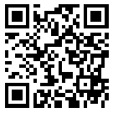
Trans Lives Matter: Remembering Our Dead Trans Day of Remembrance 2022
https://tdor.translivesmatter.info/

Slide 2

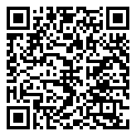
La Pocha Guayaquil, Guayas (Ecuador) stabbed. 1 Oct 2021

Slide 3
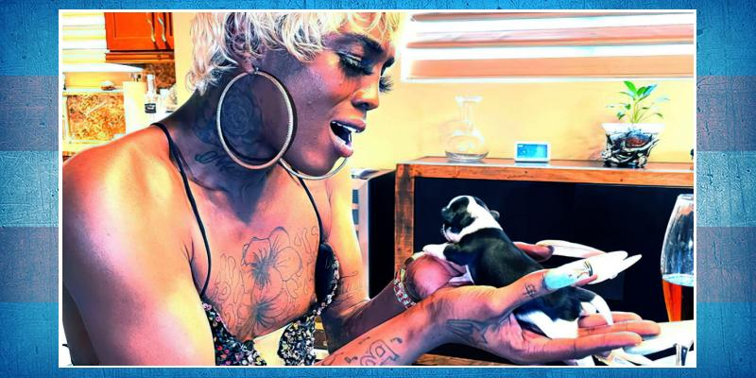
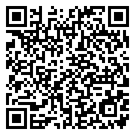
Royal Poetical Starz Age 26 Miami Gardens, Florida (USA) shot. 2 Oct 2021

Slide 4
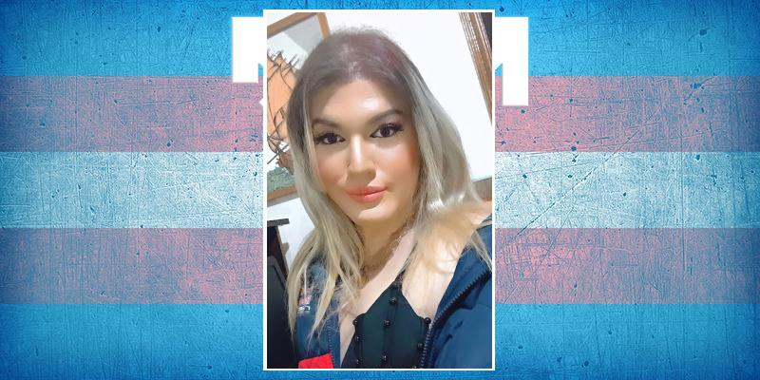
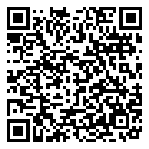
Gabriella Irente ("Hanna") Age 24 Suzano, São Paulo (Brazil) 3 Oct 2021

Slide 5
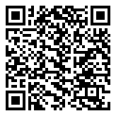
Name Unknown Ciudad de Guatemala (Guatemala) murdered. 3 Oct 2021

Slide 6
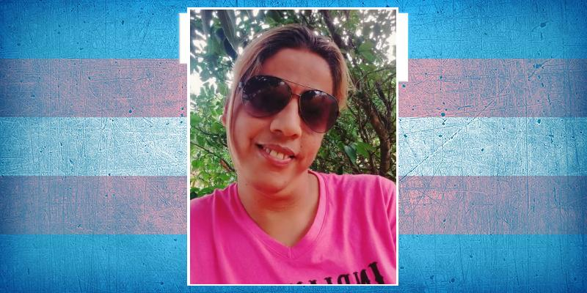
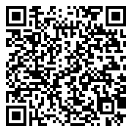
Robertinha da Silva Age 43 Serro Azul, Pernambuco (Brazil) 4 Oct 2021

Slide 7
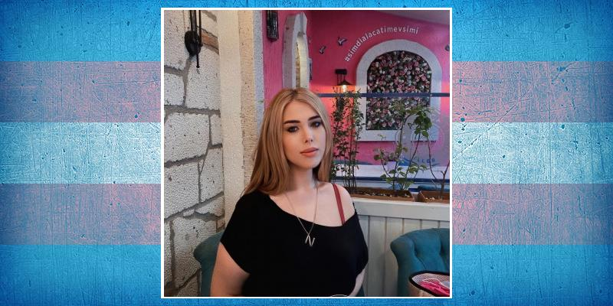
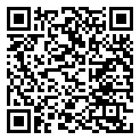
Nefes Balkan Age 28 İzmit, Kocaeli (Turkey) fell from a window. 5 Oct 2021

Slide 8
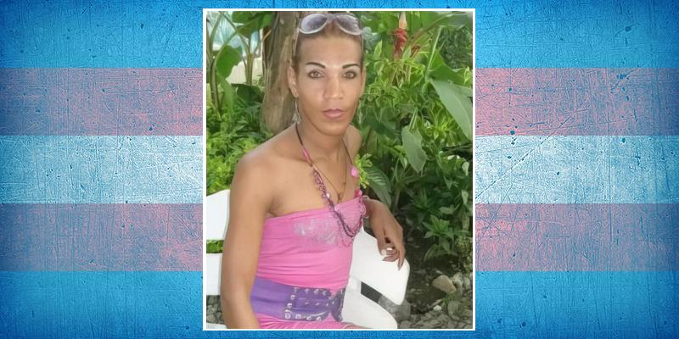
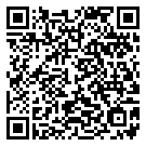
Andrea Velasco Amaya Santander de Quilichao, Cauca (Colombia) stabbed. 6 Oct 2021

Slide 9
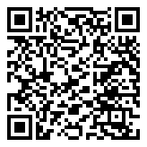
Saima Age 47 Karachi, Sindh (Pakistan) burnt by acid. 6 Oct 2021

Slide 10
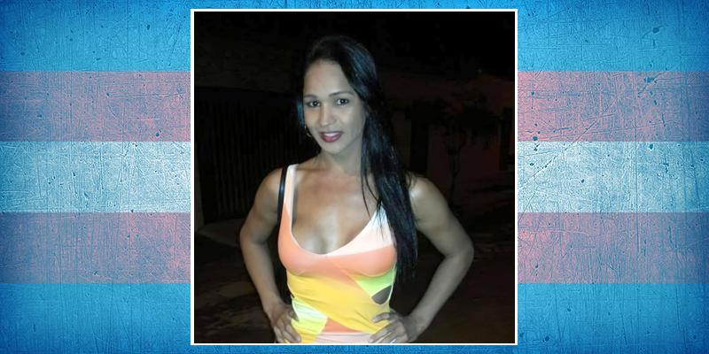
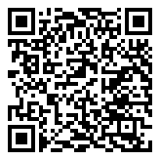
Karol Souza Rio Branco, Acre (Brazil) suicide. 8 Oct 2021

Slide 11
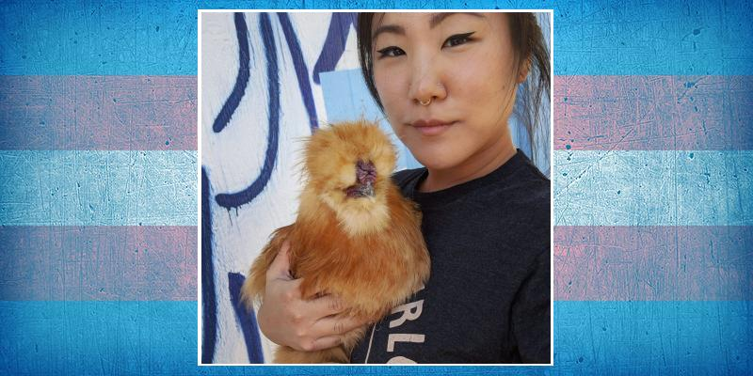
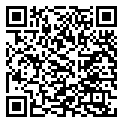
El Cho Age 30 Yucca Valley, California (USA) 9 Oct 2021

Slide 12
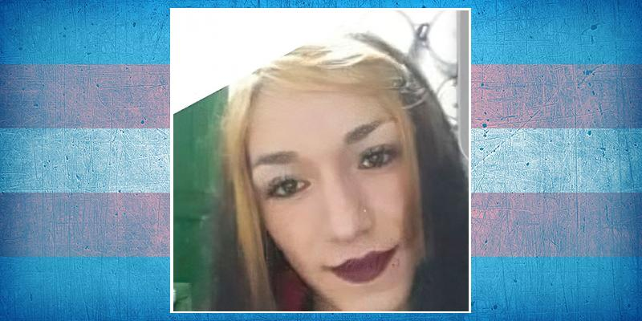
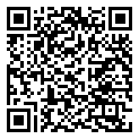
Paola ("La Gaga") Manizales, Caldas (Colombia) murdered. 10 Oct 2021

Slide 13
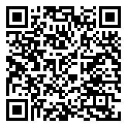
Zehava Age 22 Haifa (Israel) suicide. 10 Oct 2021

Slide 14
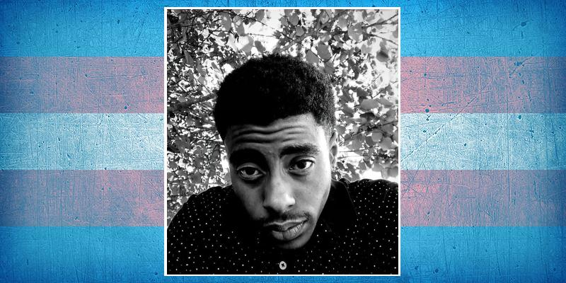
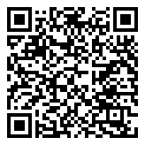
Mel Robert Groves Age 25 Jackson, Mississippi (USA) shot. 11 Oct 2021

Slide 15
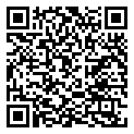
Danifi Ribeirão Preto, São Paulo (Brazil) beaten. 13 Oct 2021

Slide 16
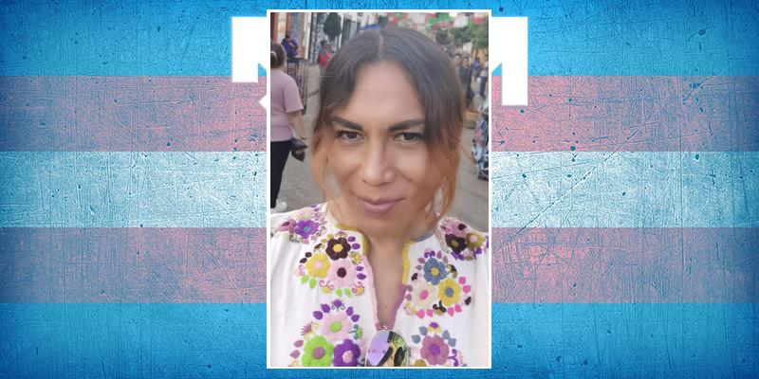
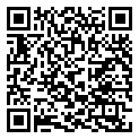
Yakki Nájera Age 46 Reynosa, Tamaulipas (Mexico) beaten and burnt. 13 Oct 2021

Slide 17
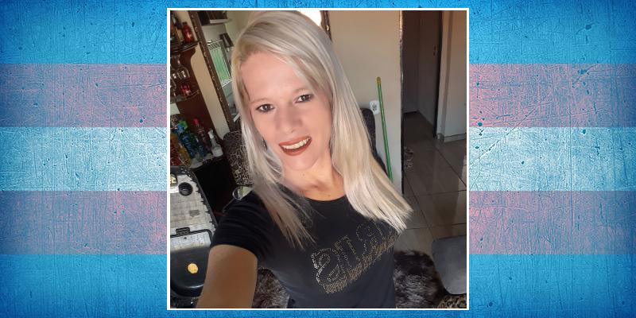
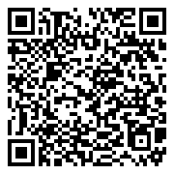
Stéfany Ferreira de Oliveira Age 38 Cassilândia, Mato Grosso do Sul (Brazil) stabbed. 14 Oct 2021

Slide 18
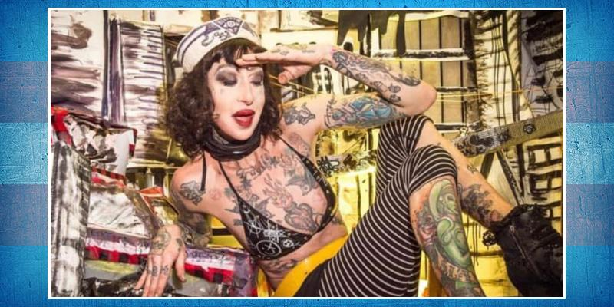
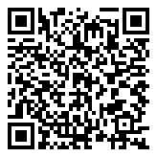
Tayda Lebón New York (USA) suicide. 14 Oct 2021

Slide 19
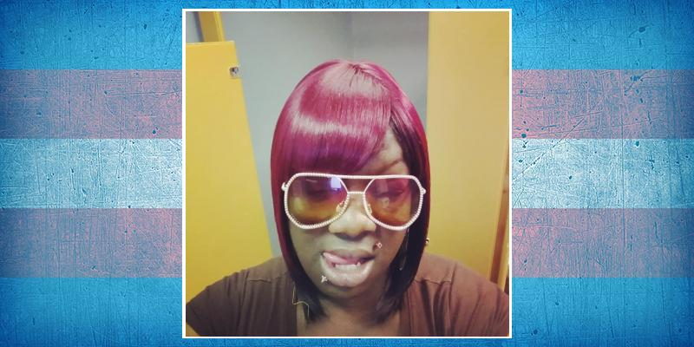
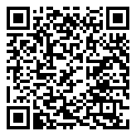
Keeva Scatter Age 34 Baton Rouge, Louisiana (USA) shot. 15 Oct 2021

Slide 20
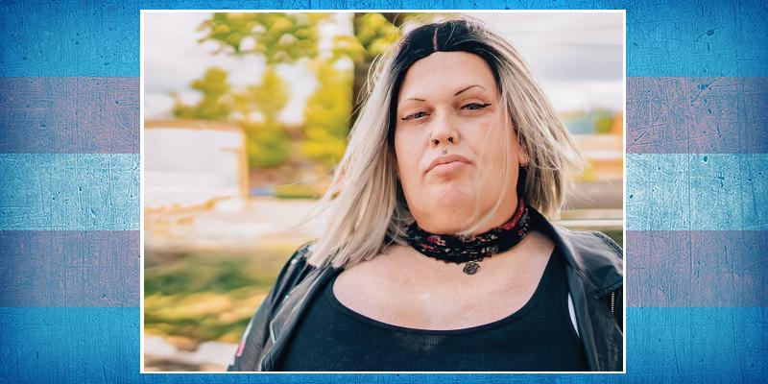
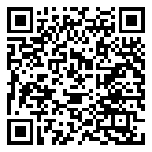
Jessi Hart Age 42 Banks, Oregon (USA) murdered. 17 Oct 2021

Slide 21
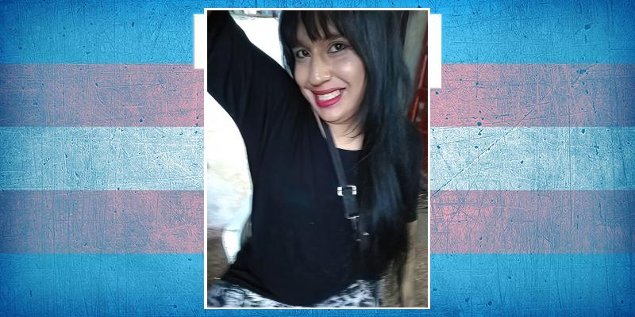
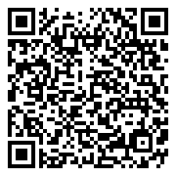
Sofía Clementina Noriega Age 30 Rosario, Santa Fe (Argentina) stabbed. 17 Oct 2021

Slide 22
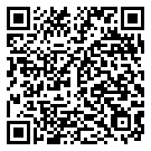
Name Unknown Age 26 Porto Alegre, Rio Grande do Sul (Brazil) shot. 17 Oct 2021

Slide 23
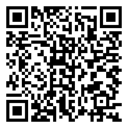
Name Unknown Viana, Espírito Santo (Brazil) beaten and strangled. 21 Oct 2021

Slide 24
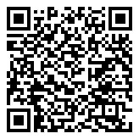
Dallila Alvorada, Rio Grande do Sul (Brazil) shot. 22 Oct 2021

Slide 25
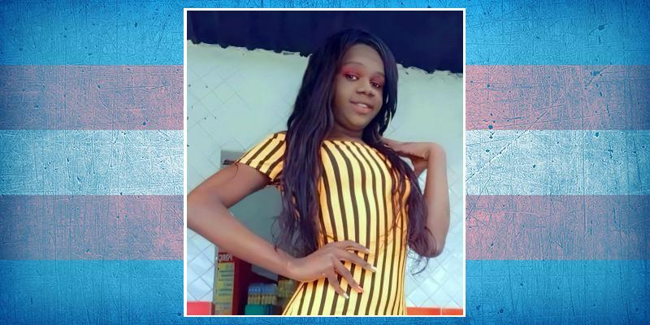
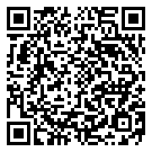
Hagatha Luana Age 20 Brasília, Distrito Federal (Brazil) shot. 23 Oct 2021

Slide 26
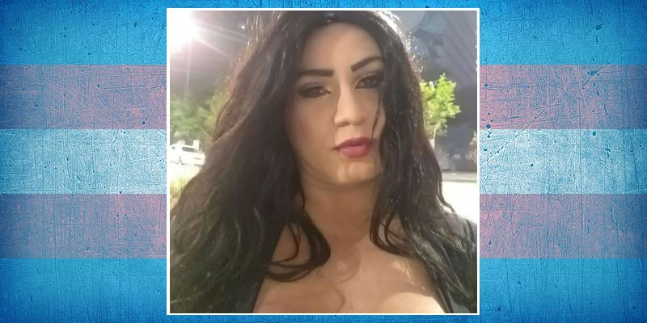
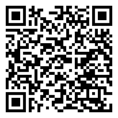
Vitória Rodrigues Ferraz Age 30 São Paulo (Brazil) stabbed. 23 Oct 2021

Slide 27
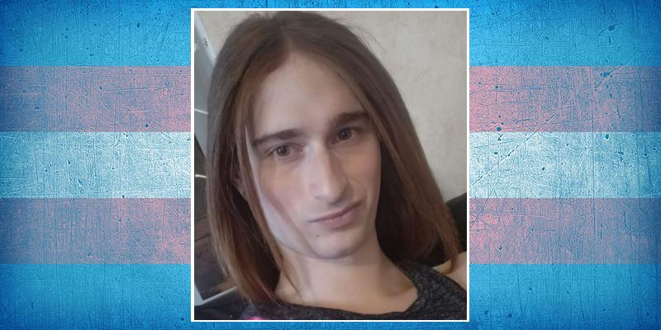
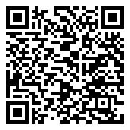
Jo Acker Age 26 Boise, Idaho (USA) shot. 25 Oct 2021

Slide 28
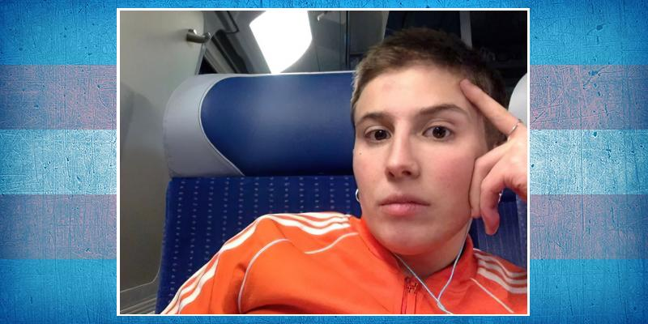
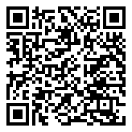
Tal Piterbraut-Merx Age 29 Paris (France) suicide. 25 Oct 2021

Slide 29
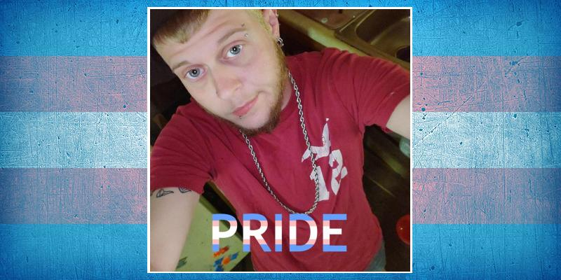
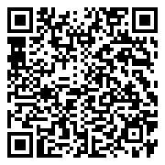
Joey Spencer ("JoJo") Age 30 Mount Airy, North Carolina (USA) suicide. 27 Oct 2021

Slide 30


A. G. Age 38 Tbilisi (Georgia) stabbed. 31 Oct 2021

Slide 31


Huapaya Morales Age 52 La Victoria, Peru (Peru) strangled. 31 Oct 2021

Slide 32


Rikkey Outumuro ("Tru Starlet") Age 39 Centralia, Washington (USA) shot. 31 Oct 2021

Slide 33


Karla Tovar Age 37 Carirubana, Falcón (Venezuela) stabbed. 1 Nov 2021

Slide 34


Jenny De Leon Age 25 Tampa, Florida (USA) murdered. 2 Nov 2021

Slide 35


Alicia Díaz Age 19-25 Ensenada, Baja California (Mexico) throat cut. 3 Nov 2021

Slide 36


Marquiisha Lawrence Age 28 Greenville, South Carolina (USA) shot. 4 Nov 2021

Slide 37


Kauany Circo Age 32 Catanduva, São Paulo (Brazil) stabbed. 6 Nov 2021

Slide 38


Danyale Johnson Age 35 Memphis, Tennessee (USA) shot. 7 Nov 2021

Slide 39

Joyi Díaz Jiménez Age 27 Carirubana, Falcón (Venezuela) shot. 8 Nov 2021

Slide 40


Larraya Age 53 Sobral, Ceará (Brazil) beaten. 8 Nov 2021

Slide 41


Angel Naira Age 36 Aliquippa, Pennsylvania (USA) shot. 11 Nov 2021

Slide 42


Haley Gabriella Feldmann Age 19 Beach, North Dakota (USA) suicide. 12 Nov 2021

Slide 43


Helen Brigette Maldonado Maldonado Age 28 Guayaquil, Guayas (Ecuador) murdered. 12 Nov 2021

Slide 44


Julya Madsan/Rogério Diego dos Santos Age 28 Juína, Matto Grosso (Brazil) stabbed. 12 Nov 2021

Slide 45


Kitty Russo Age 38 Cativá, Colón (Panama) shot. 12 Nov 2021

Slide 46


Gabriela Cabrera ("Gabi") Age 23 San Lorenzo, Central (Paraguay) 13 Nov 2021

Slide 47


Alejandra Valeria López Arauca, Caldas (Colombia) shot. 20 Nov 2021

Slide 48


Apinat Plookpluem Age 24 Ban Sang District, Prachin Buri (Thailand) throat cut. 21 Nov 2021

Slide 49


Cesi de Rosas ("Mamá Osa") Age 36 Uxpanapa, Veracruz (Mexico) shot. 21 Nov 2021

Slide 50

Name Unknown Age 27 Pune, Maharashtra (India) stoned. 23 Nov 2021

Slide 51

Berrak Age 22 İzmir (Turkey) stabbed. 26 Nov 2021

Slide 52

Name Unknown Mingora, Swat (Pakistan) suicide. 26 Nov 2021

Slide 53


Estrella Age 28 Segovia, Antioquia (Colombia) shot. 28 Nov 2021

Slide 54


Tallyta Soares Age 23 Corumbá, Mato Grosso do Sul (Brazil) stabbed. 28 Nov 2021

Slide 55

Artemisa Domínguez Chicoloapan, Estado de México (Mexico) beaten. 29 Nov 2021

Slide 56


Nikai David Age 33 Oakland, California (USA) shot. 3 Dec 2021

Slide 57

Derya Age 36 Ankara (Turkey) 4 Dec 2021

Slide 58


Andrielly Priscila de Melo Age 21 São José dos Pinhais, Paraná (Brazil) shot. 6 Dec 2021

Slide 59


Martina Caldera Age 38 Channelview, Texas (USA) shot. 6 Dec 2021

Slide 60


Cristina Cantillo Martínez Santa Marta, Magdalena (Colombia) shot. 7 Dec 2021

Slide 61


La Divaza Riohacha, La Guajira (Colombia) stabbed. 7 Dec 2021

Slide 62


Maní Bogotá, Distrito Capital (Colombia) stabbed. 7 Dec 2021

Slide 63

Name Unknown Age 22 Praia Grande, São Paulo (Brazil) stabbed. 7 Dec 2021

Slide 64


Yasmim Fontes Age 23 João Pessoa, Paraíba (Brazil) stabbed. 8 Dec 2021

Slide 65

Bijlee Karachi, Sindh (Pakistan) strangled. 10 Dec 2021

Slide 66

Ashu Age 23 Talegaon Dhamdhere, Maharashtra (India) beaten. 11 Dec 2021

Slide 67


Sarahí Atenea/Saray Ramos Izaguirre Age 31 Colima (Mexico) tortured. 11 Dec 2021

Slide 68

Name Unknown Karachi, Sindh (Pakistan) strangled. 11 Dec 2021

Slide 69

Akshitha Age 20 Salem, Tamil Nadu (India) beaten. 13 Dec 2021

Slide 70


Panimalar Age 31 Parangipettai, Tamil Nadu (India) beaten. 14 Dec 2021

Slide 71


Camury Amorim Age 20 Camaçari, Bahia (Brazil) shot. 15 Dec 2021

Slide 72

Sherly Karachi, Sindh (Pakistan) clinical neglect. 16 Dec 2021

Slide 73

Toffe Age 19 Karachi, Sindh (Pakistan) clinical neglect. 16 Dec 2021

Slide 74


Lara Vinny São Luís, Maranhão (Brazil) stabbed. 18 Dec 2021

Slide 75


Melina Zurita Plaza Age 41 Guayaquil, Guayas (Ecuador) cosmetic filler complications. 20 Dec 2021

Slide 76

Usha Rani Patna, Bihar (India) beaten and shot. 20 Dec 2021

Slide 77


Za'niyah Williams Age 21 Houston, Texas (USA) run over. 20 Dec 2021

Slide 78

Soni Patna, Bihar (India) shot. 21 Dec 2021

Slide 79


Angie Carolina Patiño Age 26 Pereira, Risaralda (Colombia) stabbed. 22 Dec 2021

Slide 80

Name Unknown Rawalpindi, Punjab (Pakistan) strangled and shot. 26 Dec 2021

Slide 81


Ke'Yahonna Stone Age 32 Indianapolis (USA) shot. 28 Dec 2021

Slide 82


Bielzinho Costa Timon, Maranhão (Brazil) shot. 29 Dec 2021

Slide 83


Amelia Furniss Leonhart Age 22 Idaho Falls (USA) suicide. 30 Dec 2021

Slide 84


Bárbara Waimaran El Jícaro, El Progreso (Guatemala) tortured. 30 Dec 2021

Slide 85


Nikki Turrietta Age 31 Albuquerque, New Mexico (USA) shot. 31 Dec 2021

Slide 86


Amarey Lej (Myara) Age 21 Pittsburgh, Pennsylvania (USA) shot. 1 Jan 2022

Slide 87


Blenda Schneider (Beatriz) Age 34 Cabo de Santo Agostinho, Pernambuco (Brazil) shot. 2 Jan 2022

Slide 88


Briza Garces Florez Age 40 Den Haag, South Holland (Netherlands) stabbed. 2 Jan 2022

Slide 89


Duval Princess Age 24 Jacksonville, Florida (USA) 2 Jan 2022

Slide 90


Joseline Calito Amatitlán, Guatemala (Guatemala) shot. 2 Jan 2022

Slide 91


Aldana Lorenz Age 35 Santa Fe (Argentina) beaten. 3 Jan 2022

Slide 92


Zen Black Age 28 Downpatrick, County Down, Northern Ireland (United Kingdom) stabbed. 3 Jan 2022

Slide 93


Karla Valentina Espinoza Loor Age 31 Guayaquil, Guayas (Ecuador) stabbed. 4 Jan 2022

Slide 94


Cristian Nicola Age 27 Guayaquil, Guayas (Ecuador) shot. 5 Jan 2022

Slide 95


Dayana Karrington Age 30 Cárdenas, Tabasco (Mexico) beaten and shot. 5 Jan 2022

Slide 96


Blair Envy Brighton, East Sussex (United Kingdom) suicide. 5 Jan 2022

Slide 97


F. E. Caetano Age 44 Santana do Acaraú, Ceará (Brazil) shot. 6 Jan 2022

Slide 98

Lovely Jashore, Khulna (Bangladesh) stabbed. 8 Jan 2022

Slide 99

Name Unknown Age 30-35 Karachi, Sindh (Pakistan) strangled. 8 Jan 2022

Slide 100


Kauê Vestemberg Age 22 Guarapuava, Paraná (Brazil) suicide. 9 Jan 2022

Slide 101


Jasmyne da Silva Age 20 Maceió, Alagoas (Brazil) stabbed. 10 Jan 2022

Slide 102


Thalía Rodríguez Age 45 Tegucigalpa, Distrito Central (Honduras) shot. 10 Jan 2022

Slide 103


Natasha Simonini Age 34 Viareggio, Lucca (Italy) COVID-19. 12 Jan 2022

Slide 104

Paloma Juchitán de Zaragoza, Oaxaca (Mexico) shot. 12 Jan 2022

Slide 105

Name Unknown Age 46 Béccar, Buenos Aires (Argentina) stabbed. 13 Jan 2022

Slide 106


Karina López Age 40 Xalapa, Veracruz (Mexico) asphyxiation. 14 Jan 2022

Slide 107


Gael Pandinho Age 19 Macapá, Amapá (Brazil) suicide. 16 Jan 2022

Slide 108


Günay Özyıldız Age 48 İzmir (Turkey) stabbed. 16 Jan 2022

Slide 109


Emma Boland Age 15 Bampton, Oxfordshire (United Kingdom) suicide. 17 Jan 2022

Slide 110


Pérola Almeida ("Steffany Melody") Age 22 Boa Vista, Roraima (Brazil) stabbed. 17 Jan 2022

Slide 111

Name Unknown Age 25 Curitiba, Paraná (Brazil) shot. 17 Jan 2022

Slide 112


Arelis Cabezas Sierra Age 38 Bogotá, Distrito Capital (Colombia) cosmetic procedure complications. 20 Jan 2022

Slide 113


Wendy Espinosa Age 42 La Maná, Cotopaxi (Ecuador) shot. 20 Jan 2022

Slide 114


Ximena García Age 24 Ciudad de México (Mexico) stabbed. 22 Jan 2022

Slide 115


Paulinha Ferrara Age 31 Timon, Maranhão (Brazil) stoned and stabbed. 23 Jan 2022

Slide 116

Citlalli Age 42 Unión Hidalgo, Oaxaca (Mexico) shot. 24 Jan 2022

Slide 117


Babalu Vendraminy São Gonçalo, Rio de Janeiro (Brazil) suicide. 25 Jan 2022

Slide 118

Name Unknown Bannu, Khyber Pakhtunkhwa (Pakistan) shot. 26 Jan 2022

Slide 119


Alexa Valle Landaverde Age 22 Quezaltepeque, La Libertad (El Salvador) murdered. 28 Jan 2022

Slide 120


Doski Azad Age 23 Duhok (Iraq) shot. 28 Jan 2022

Slide 121


León Pindo Cuenca Age 35 Tilalles, El Oro (Ecuador) shot. 29 Jan 2022

Slide 122

Pamela Correia Cabo Frio, Rio de Janeiro (Brazil) beaten. 30 Jan 2022

Slide 123

Name Unknown Porto da Folha, Sergipe (Brazil) shot. 31 Jan 2022

Slide 124


Zirve Soylu Istanbul (Turkey) suicide. 1 Feb 2022

Slide 125

Michele Age 28 Cachoeiro de Itapemirim, Espírito Santo (Brazil) stabbed. 4 Feb 2022

Slide 126


Diany Cavalcante da Silva Manaus, Amazonas (Brazil) strangled. 4 Feb 2022

Slide 127


Bella Analía Vera Age 34 Babahoyo, Los Ríos (Ecuador) cosmetic filler complications. 5 Feb 2022

Slide 128


Kimberlly Villegas Ibagué, Tolima (Colombia) stabbed. 6 Feb 2022

Slide 129

Hanar Mariwan, Kurdistan (Iran) suicide. 6 Feb 2022

Slide 130

Name Unknown Age 12 Milton Keynes, Buckinghamshire (United Kingdom) suicide. 6 Feb 2022

Slide 131


Beatriz Souza/Beatriz Bastos Age 38 Paris (France) overdose from a spiked drink. 7 Feb 2022

Slide 132


Valentín Quezada Saldías Age 25 Chillán, Diguillín (Chile) 7 Feb 2022

Slide 133


Nicoly Age 19 Varginha, Minas Gerais (Brazil) suicide. 8 Feb 2022

Slide 134


Destinee Lashaee Age 29 Houston, Texas (USA) suicide. 9 Feb 2022

Slide 135


Matthew Angelo Spampinato Age 21 New Castle, Delaware (USA) run over. 9 Feb 2022

Slide 136


Shay Patten Walker Age 23 London (United Kingdom) suicide. 9 Feb 2022

Slide 137

Bunty Taxila, Punjab (Pakistan) stabbed. 10 Feb 2022

Slide 138


Iggy Rose Cardiff, Wales (United Kingdom) possible suicide. 10 Feb 2022

Slide 139


Loren Guzmán Age 33 Irapuato, Guanajuato (Mexico) murdered. 10 Feb 2022

Slide 140


Priscila Santos Age 27 Teixeira de Freitas, Bahia (Brazil) shot. 10 Feb 2022

Slide 141


Sofia Gisely Age 22 Fortaleza, Ceará (Brazil) stoned. 11 Feb 2022

Slide 142


Júlia dos Santos Silva Age 23 Palmares, Pernambuco (Brazil) shot. 11 Feb 2022

Slide 143


Sabrina Fernanda de Oliveira Age 20 São José do Rio Preto, São Paulo (Brazil) stabbed. 11 Feb 2022

Slide 144


C. de Azevedo Soares Age 31 São Bento do Una, Pernambuco (Brazil) shot. 12 Feb 2022

Slide 145


J. L. da Silva Age 18 São Bento do Una, Pernambuco (Brazil) shot. 12 Feb 2022

Slide 146


Naomie Skinner Age 25 Highland Park, Michigan (USA) shot. 12 Feb 2022

Slide 147


Cypress Ramos Age 21 Lubbock, Texas (USA) beaten. 13 Feb 2022

Slide 148


Larissa Correia Vitória da Conquista, Bahia (Brazil) shot. 14 Feb 2022

Slide 149


Dorce Gamalama Age 58 Jakarta (Indonesia) COVID-19. 16 Feb 2022

Slide 150

Johana Sánchez Age 46 Armenia, Quindío (Colombia) murdered. 16 Feb 2022

Slide 151


Gabi Mattos Age 17 Aracaju, Sergipe (Brazil) shot. 19 Feb 2022

Slide 152


Isabela Vargas Manizales, Caldas (Colombia) stabbed. 19 Feb 2022

Slide 153


Pamela Age 30-35 Ciudad de México (Mexico) fell from a vehicle. 20 Feb 2022

Slide 154


Tifany Meneses Age 24 Puerto Tejada, Cauca (Colombia) shot. 20 Feb 2022

Slide 155


Gabrielly Monteiro São Luís, Maranhão (Brazil) stabbed. 22 Feb 2022

Slide 156


Britney Spears Belo Horizonte, Minas Gerais (Brazil) stabbed. 23 Feb 2022

Slide 157


Brunna Kimberlly Age 27 Aparecida de Goiânia, Goiás (Brazil) shot. 24 Feb 2022

Slide 158


Samuel Hoffmann Age 30-40 Billesholm, Skåne (Sweden) murdered. 24 Feb 2022

Slide 159


Verônica Martineli São Paulo (Brazil) stabbed. 25 Feb 2022

Slide 160

Name Unknown Age 52 Hamburg (Germany) suicide. 25 Feb 2022

Slide 161

Cristina Blackstar Lausanne, Vaud (Switzerland) stabbed. 25 Feb 2022

Slide 162


Paloma Vazquez Age 29 Houston, Texas (USA) shot. 26 Feb 2022

Slide 163

Katherine Salazar Puerto Quijarro, Santa Cruz (Bolivia) 27 Feb 2022

Slide 164

Luana Riço Costa Campos dos Goytacazes, Rio de Janeiro (Brazil) murdered. 28 Feb 2022

Slide 165

Adrien Baptiste Luckas Nice, Alpes-Maritimes (France) suicide. 1 Mar 2022

Slide 166


Gwenn Agathe Linski Age 27 Toulouse, Haute-Garonne (France) suicide. 2 Mar 2022

Slide 167

Name Withheld Ouagadougou, Kadiogo (Burkina Faso) stabbed. 2 Mar 2022

Slide 168


Brent Wood Age 31 Seattle, Washington (USA) beaten. 3 Mar 2022

Slide 169


Milo Winslow Age 30 Lincoln, Nebraska (USA) suicide. 3 Mar 2022

Slide 170


Isabela de Araújo Farias Aparecida de Goiânia, Goiás (Brazil) stabbed. 4 Mar 2022

Slide 171

Viridiana Tezoyuca, Estado de México (Mexico) stabbed. 4 Mar 2022

Slide 172


Duda Marins Age 27 Patos de Minas, Minas Gerais (Brazil) beaten. 7 Mar 2022

Slide 173


Kathryn Newhouse Age 19 Canton, Georgia (USA) shot. 9 Mar 2022

Slide 174

Luo Age 21 Wuhan, Hubei (China) stabbed. 9 Mar 2022

Slide 175


Andrea Rozo Rolón ("La Leona") Age 41-50 Bucaramanga, Santander (Colombia) stabbed. 11 Mar 2022

Slide 176


Paula Mesquita Age 34 Castanhal, Pará (Brazil) shot. 11 Mar 2022

Slide 177


Paulo Vaz ("Popó Vaz") Age 36 São Paulo (Brazil) possible suicide. 14 Mar 2022

Slide 178


Patricia Mazzini Manco Age 37 Lurín, Lima (Peru) shot. 15 Mar 2022

Slide 179


Soraia Age 59 Raposa, Maranhão (Brazil) stabbed. 15 Mar 2022

Slide 180


Elise Malary Age 31 Evanston, Illinois (USA) drowned. 17 Mar 2022

Slide 181


Chaand Mardan, Khyber-Pakhtunkhwa (Pakistan) shot. 18 Mar 2022

Slide 182


Mano Peshawar, Khyber-Pakhtunkhwa (Pakistan) shot. 18 Mar 2022

Slide 183


Tatiana Labelle ("Tee Tee") Age 33 Chicago, Illinois (USA) murdered. 19 Mar 2022

Slide 184


Celene Gabriela Colantinio ("Nati") Age 31 Mina Clavero, Córdoba (Argentina) possible suicide. 21 Mar 2022

Slide 185

Sameera Iftikhar Mansehra, Khyber Pakhtunkhwa (Pakistan) shot. 21 Mar 2022

Slide 186


Estrellita Saltos Robalino Age 38 Guayaquil, Guayas (Ecuador) shot. 22 Mar 2022

Slide 187


Priscila Santos ("Priscila Diva") Age 29 Mairiporã, São Paulo (Brazil) murdered. 22 Mar 2022

Slide 188

V. R. V. Age 34 Matías Romero, Oaxaca (Mexico) shot. 23 Mar 2022

Slide 189


Quinn Mowrer Gustin Age 20 Salt Lake City, Utah (USA) suicide. 24 Mar 2022

Slide 190


Yessi Montero Age 27 Nautla, Veracruz (Mexico) tortured and shot. 24 Mar 2022

Slide 191


Coconut Mardan, Khyber Pakhtunkhwa (Pakistan) shot. 26 Mar 2022

Slide 192


Kesha Webster Age 24 Jackson, Mississipi (USA) murdered. 26 Mar 2022

Slide 193

S. Peshawar, Khyber Pakhtunkhwa (Pakistan) shot. 26 Mar 2022

Slide 194


Kai Khan Age 18 Great Bend, Kansas (USA) suicide. 27 Mar 2022

Slide 195

M. Shiekh Age 32 Gurugram, Haryana (India) stoned. 28 Mar 2022

Slide 196


Mirza-Hélène Deneuve ("Julles") Age 26 Le Havre, Seine-Maritime (France) suicide. 28 Mar 2022

Slide 197


Fernanda López Somer Age 33 Concordia, Entre Rios (Argentina) stabbed. 30 Mar 2022

Slide 198


Marcela Gomes Fonseca Age 17 Juína, Mato Grosso (Brazil) suicide. 30 Mar 2022

Slide 199


Lorena Age 31 Pacatuba, Ceará (Brazil) shot. 30 Mar 2022

Slide 200


Ezra Amos Age 22 Hamilton, Ontario (Canada) possible suicide. 31 Mar 2022

Slide 201


Miia Love Parker Chester, Pennsylvania (USA) shot. 1 Apr 2022

Slide 202


Ariyanna Mitchell Age 17 Hampton, Virginia (USA) shot. 2 Apr 2022

Slide 203


Crislaine dos Santos Age 45 Serra, Espirito Santo (Brazil) shot. 3 Apr 2022

Slide 204


Shelony Viloria ("Riqui pa Riqui") Age 22 El Bagre, Antioquia (Colombia) shot. 3 Apr 2022

Slide 205

Yaneth Age 22 Colima (Mexico) shot. 3 Apr 2022

Slide 206

Name Unknown Fresnillo, Zacatecas (Mexico) shot. 3 Apr 2022

Slide 207

Cristhian Cuernavaca, Morelos (Mexico) shot. 4 Apr 2022

Slide 208


Grecia Devora Zacatecas (Mexico) shot. 4 Apr 2022

Slide 209


Amani Frieden Age 18 Aracaju, Sergipe (Brazil) suicide. 5 Apr 2022

Slide 210

Name Unknown Age 35 Jiutepec, Morelos (Mexico) beaten. 5 Apr 2022

Slide 211


Lucia Smitt Bogotá, Distrito Capital (Colombia) murdered. 6 Apr 2022

Slide 212

Name Unknown Age 30 Guadalajara, Jalisco (Mexico) murdered. 8 Apr 2022

Slide 213

Anika Age 23 Bengaluru, Karnataka (India) beaten. 9 Apr 2022

Slide 214

Name Unknown Fortaleza, Ceará (Brazil) strangled. 9 Apr 2022

Slide 215


Felis Joy Age 16 Chișinău (Moldova) suicide. 11 Apr 2022

Slide 216


Fern Feather Age 29 Morristown, Vermont (USA) stabbed. 12 Apr 2022

Slide 217

Name Unknown Ciudad Juarez, Chihuahua (Mexico) strangled. 12 Apr 2022

Slide 218

Mildred Castillo Jiménez Age 29 Bucaramanga, Santander (Colombia) stabbed. 13 Apr 2022

Slide 219

R. da Silva Franco Age 29 Resende, Rio de Janeiro (Brazil) shot. 13 Apr 2022

Slide 220


Fernandinha Age 28 Barreira, Ceará (Brazil) stabbed and beheaded. 14 Apr 2022

Slide 221


Ace Scott Age 15 Kansas City, Missouri (USA) 15 Apr 2022

Slide 222


Larissa Carvalho Natal, Rio Grande do Norte (Brazil) stabbed. 15 Apr 2022

Slide 223

Name Unknown Vila Velha, Espírito Santo (Brazil) shot. 15 Apr 2022

Slide 224

Name Unknown Phnom Penh (Cambodia) strangled. 15 Apr 2022

Slide 225


Kenna Leigh Gillock Age 26 Gold Hill, Oregon (USA) suicide. 17 Apr 2022

Slide 226


Kelly Keyze Rosa Age 32 Caeté, Minas Gerais (Brazil) shot. 17 Apr 2022

Slide 227


Tiffany Landino Bracho Age 22 Valledupar, Cesar (Colombia) stabbed. 17 Apr 2022

Slide 228


Renata Cavalcante/Renata Ferraz Age 16 São José de Espinharas, Paraíba (Brazil) stabbed. 19 Apr 2022

Slide 229


Karla Michelle Chavira Chávez Age 30 Pánuco, Veracruz (Mexico) stabbed. 20 Apr 2022

Slide 230

Morgana Age 41 Rome, Lazio (Italy) 20 Apr 2022

Slide 231


Asher Garcia Age 14 Frazee, Minnesota (USA) suicide. 21 Apr 2022

Slide 232


Sabrina Kalegary Age 33 Belo Horizonte, Minas Gerais (Brazil) beaten and stabbed. 21 Apr 2022

Slide 233

C. Messias Age 24 Goiânia, Goiás (Brazil) shot. 22 Apr 2022

Slide 234


Roxy Tumbaco Orrala Age 35 La Libertad (Ecuador) shot. 22 Apr 2022

Slide 235

Damien Fraser Age 21 Sydney Mines, Nova Scotia (Canada) 23 Apr 2022

Slide 236


Mariana Jaramillo Santa Elena, Valle del Cauca (Colombia) murdered. 26 Apr 2022

Slide 237


Karla Torreón, Coahuila (Mexico) stabbed. 1 May 2022

Slide 238

Name Unknown Puri, Odisha (India) suicide. 1 May 2022

Slide 239


Anne Souza Maraguá, Espírito Santo (Brazil) shot. 2 May 2022

Slide 240

Michele Marques ("Mona") Age 30 Contagem, Minas Gerais (Brazil) shot. 2 May 2022

Slide 241


Carla Cris Age 39 Lagarto, Sergipe (Brazil) beaten. 3 May 2022

Slide 242


Naomi Fernandes de Sousa Age 27 Parauapebas, Pará (Brazil) shot. 7 May 2022

Slide 243

Adiela García Castaño Age 50 Santa Rosa de Cabal, Risaralda (Colombia) stabbed. 7 May 2022

Slide 244


Ángel Rogríguez Hernández ("Ximena") Irapuato, Guanajuato (Mexico) killed by a drunk driver. 8 May 2022

Slide 245


Melany Fox Irapuato, Guanajuato (Mexico) killed by a drunk driver. 8 May 2022

Slide 246


Paris ("Victoría Secrett") Irapuato, Guanajuato (Mexico) killed by a drunk driver. 8 May 2022

Slide 247


Pepa Álvarez Irapuato, Guanajuato (Mexico) killed by a drunk driver. 8 May 2022

Slide 248


Ray Muscat Age 24 Independence Township, Michigan (USA) shot. 8 May 2022

Slide 249


Trini Age 31 Irapuato, Guanajuato (Mexico) killed by a drunk driver. 8 May 2022

Slide 250


Ruby Taverner Age 22 Independence Township, Michigan (USA) suicide. 9 May 2022

Slide 251


Michelle S Tarrio New York (USA) cosmetic filler complications. 10 May 2022

Slide 252


Bruna Lagoa Grande, Pernambuco (Brazil) shot. 13 May 2022

Slide 253

Sanjana Age 30 Bengaluru, Karnataka (India) beaten. 13 May 2022

Slide 254


Sasha Mason Age 45 Zebulon, North Carolina (USA) shot. 13 May 2022

Slide 255

Name Unknown Age 15 Le Mans, Sarthe (France) suicide. 13 May 2022

Slide 256

Estefani Rodrigues Soares Age 18 Natal, Rio Grande do Norte (Brazil) stabbed. 14 May 2022

Slide 257


Nedra Sequence Morris ("Sequence") Age 50 Opa-locka, Florida (USA) shot. 14 May 2022

Slide 258


Khay Abdulgajir Tawi-Tawi, Bangsamoro (Philippines) stabbed. 17 May 2022

Slide 259


Sherin Celin Mathew Age 26 Kochi, Kerala (India) suicide. 17 May 2022

Slide 260

Name Unknown Belo Horizonte, Minas Gerais (Brazil) beaten and run over. 17 May 2022

Slide 261


Maddie Hoffman Age 47 Malvern, Pennsylvania (USA) shot. 19 May 2022

Slide 262


Mônica Ribeiro Age 36 Blumenau, Santa Catarina (Brazil) shot. 19 May 2022

Slide 263


Maddie Dickens Age 28 Roseville, Minnesota (USA) possible suicide. 20 May 2022

Slide 264


Larah Skalwalker Age 26 Maceió, Alagoas (Brazil) drowned. 22 May 2022

Slide 265


Miguel Ángel Peréz Leal Age 36 San Luis Río Colorado, Sonora (Mexico) asphixiated. 22 May 2022

Slide 266


Bianca Machado Rodrigues Age 33 Aparecida de Goiânia, Goiás (Brazil) suffocated and dismembered. 25 May 2022

Slide 267


Danna Nunes Age 27 Bagé, Rio Grande do Sul (Brazil) suicide. 25 May 2022

Slide 268


Alice Litman Age 20 Brighton, Sussex (United Kingdom) suicide. 26 May 2022

Slide 269


DeeDee Hall Age 47 Dallas, Texas (USA) died in custoday. 26 May 2022

Slide 270


La Flaca Pereira, Risaralda (Colombia) shot. 26 May 2022

Slide 271


Joyce Medeiros Rio de Janeiro (Brazil) strangled. 27 May 2022

Slide 272

Camila Manaus, Amazonas (Brazil) beaten. 28 May 2022

Slide 273


Amy Winehouse Tegucigalpa, Distrito Central (Honduras) tortured and murdered. 28 May 2022

Slide 274

I. Age 35 Lahore, Punjab (Pakistan) stabbed. 29 May 2022

Slide 275


Rany Fada Age 19 Belém do São Francisco, Pernambuco (Brazil) stoned. 30 May 2022

Slide 276

P. Age 32 Bengaluru, Karnataka (India) stabbed. 30 May 2022

Slide 277


Chanelika Y'Ella Dior Hemingway ("Sid") Age 30 Albany, New York (USA) murdered. 31 May 2022

Slide 278

Name Unknown Piedrea Negras, Coahuila (Mexico) 1 Jun 2022

Slide 279


Yuridia Pizarro Age 55 Iquique, Tarapacá (Chile) murdered. 2 Jun 2022

Slide 280


Rexy Que Age 26 Wichita, Kansas (USA) suicide. 3 Jun 2022

Slide 281


Camila Boloco/Camila Ignacia Age 42 Ciudad de Mexico (Mexico) murdered. 4 Jun 2022

Slide 282


Carla Machado Noya Age 25 El Banco, Magdalena (Colombia) shot. 4 Jun 2022

Slide 283


Camilla Bertolotti Age 43 Liguria (Italy) beaten and shot. 7 Jun 2022

Slide 284


Lorrayne Alves Age 22 Anápolis, Goiás (Brazil) cosmetic filler complications. 8 Jun 2022

Slide 285

Lu Henrique Age 22 Manaus, Amazonas (Brazil) shot. 8 Jun 2022

Slide 286


Sheeza Age 18-20 Dera Ismail Khan, Khyber Pakhtunkhwa (Pakistan) shot. 10 Jun 2022

Slide 287


Vergel Catalonia Tumicad Age 24 Ilagan, Isabela (Philippines) beaten. 10 Jun 2022

Slide 288


Cloe Bianco Age 58 Belluno (Italy) suicide. 11 Jun 2022

Slide 289

Estefanía Fernández ("Betty") Santa Marta, Magdalena (Colombia) shot. 11 Jun 2022

Slide 290

Sasha Age 15 Catania, Sicily (Italy) suicide. 11 Jun 2022

Slide 291


Atena Queiroz da Silva Age 19 Santa Cruz do Capibaribe, Pernambuco (Brazil) stoned and stabbed. 12 Jun 2022

Slide 292

Suany Maradiaga Age 31 San Pedro Sula, Cortés (Honduras) shot and run over. 12 Jun 2022

Slide 293


Paris Rich Age 25 San Diego, California (USA) 13 Jun 2022

Slide 294


Vianey Navarrete Age 26-30 Cancun, Quintana Roo (Mexico) murdered. 13 Jun 2022

Slide 295


Brazil Johnson Age 28 Milwaukee, Wisconsin (USA) shot. 15 Jun 2022

Slide 296


Thiraphong Lamluea Age 31 Prasat, Surin (Thailand) beaten. 15 Jun 2022

Slide 297


Danielly do Carmo Santos Age 24 Tucuruí, Pará (Brazil) stabbed. 16 Jun 2022

Slide 298


Name Unknown Castanhal, Pará (Brazil) shot. 18 Jun 2022

Slide 299


F. C. Ferreira Lima Age 26 Casimiro de Abreu, Rio de Janeiro (Brazil) shot. 18 Jun 2022

Slide 300

Name Unknown Ecatepec, Estado de México (Mexico) shot. 19 Jun 2022

Slide 301


Shawmayné McClam Age 27 Gulfport, Mississippi (USA) shot. 21 Jun 2022

Slide 302

Kaif Mansehra, Khyber Pakhtunkhwa (Pakistan) shot. 22 Jun 2022

Slide 303


Carmem Lúcia Alves de Souza ("Lu") Age 53 São Sebastião, Distrito Federal (Brazil) strangled. 22 Jun 2022

Slide 304


Estrellita Martínez Correa Age 22 Fonseca, La Guajira (Colombia) shot. 24 Jun 2022

Slide 305


Victoria de Lima Age 25 Maringá, Paraná (Brazil) shot. 25 Jun 2022

Slide 306


Cromada Age 32 Fortaleza, Ceará (Brazil) shot. 27 Jun 2022

Slide 307


Kitty Monroe Memphis, Tennessee (USA) shot. 29 Jun 2022

Slide 308

A. Masih Rawalpindi, Punjab (Pakistan) stabbed. 1 Jul 2022

Slide 309


Nancy Sacul Tut Age 34 Ciudad de Guatemala (Guatemala) shot. 2 Jul 2022

Slide 310

C. A. Castillo Morales Age 35 Cuernavaca, Morelos (Mexico) run over. 4 Jul 2022

Slide 311


Cherry Bush Age 48 Los Angeles, California (USA) shot. 6 Jul 2022

Slide 312


Isabella Sandoval Age 32 Rionegro, Antioqua (Colombia) 7 Jul 2022

Slide 313


Jasper Aaron Lynch Age 26 McClean, Virginia (USA) shot. 7 Jul 2022

Slide 314


Jimmie “Jay” Lee Age 20 Lafayette County, Mississippi (USA) 8 Jul 2022

Slide 315


Kelly Romero Hernández Age 25 Santa Ana Atzacan, Veracruz (Mexico) murdered. 8 Jul 2022

Slide 316

Name Unknown Guadalajara, Jalisco (Mexico) 8 Jul 2022

Slide 317


Sabrina Houston Age 37 Talinn, Harju (Estonia) stabbed. 9 Jul 2022

Slide 318


Taylor Wotton-under-Edge, Gloucestershire (United Kingdom) suicide. 9 Jul 2022

Slide 319


Martasia Richmond Age 30 Chicago, Illinois (USA) stabbed. 11 Jul 2022

Slide 320


Lara Croft Age 34 Cariacica, Espírito Santo (Brazil) shot. 12 Jul 2022

Slide 321


Tamara Campos Age 34 Piedras Negras, Coahuila (Mexico) 13 Jul 2022

Slide 322

Nikki Betul, Madhya Pradesh (India) strangled. 14 Jul 2022

Slide 323


Ana Paula Albino Lovera Age 36 Armenia, Quindío (Colombia) stabbed. 16 Jul 2022

Slide 324


Toi Davis Age 34 Milwaukee, Wisconsin (USA) 16 Jul 2022

Slide 325


Valis Ortíz Age 39 Cuidad de México (Mexico) suicide. 17 Jul 2022

Slide 326

Renatinha Londrina, Paraná (Brazil) 17 Jul 2022

Slide 327


Keshia Chanel Geter Age 26 Augusta, Georgia (USA) shot. 20 Jul 2022

Slide 328


Sasha Barrionuevo Age 38 Mar del Plata, Buenos Aires (Argentina) 20 Jul 2022

Slide 329


Lavinia da Silva Pereira Age 25 Macaé, Rio de Janeiro (Brazil) shot. 22 Jul 2022

Slide 330

Name Unknown Rio de Janeiro (Brazil) suicide. 22 Jul 2022

Slide 331

Camila Rodrigues Dias Age 41-43 Cuiabá, Mato Grosso (Brazil) beaten. 24 Jul 2022

Slide 332


Hayden Nevah Davis Age 28 Detroit, Michigan (USA) shot. 25 Jul 2022

Slide 333


Kamila Marie Swann ("Dee Dee", "Kandii Redd") Age 29 Kansas City, Missouri (USA) stabbed. 25 Jul 2022

Slide 334


Shehnaz Peshawar, Khyber Pakhtunkhwa (Pakistan) murdered. 25 Jul 2022

Slide 335


Deysianne França Age 32 Salvador, Bahia (Brazil) stabbed. 26 Jul 2022

Slide 336


Sara Nicole Muñoz Palacios Age 33 Cali, Valle del Cauca (Colombia) shot. 27 Jul 2022

Slide 337


Marisela Castro Age 39 Houston, Texas (USA) shot. 29 Jul 2022

Slide 338


Isabella Yanka Age 20 Ceilândia, Distrito Federal (Brazil) stabbed. 30 Jul 2022

Slide 339


Muskan Age 35 Unnao, Uttar Pradesh (India) murdered. 30 Jul 2022

Slide 340


Ignacia Palma Age 26 Valparaíso (Chile) stabbed and burned. 3 Aug 2022

Slide 341


Amanda Îaûara Ka'aeté São Paulo (Brazil) 3 Aug 2022

Slide 342


Kimbella Kimble Age 21 Gulfport, Mississippi (USA) died in custody. 6 Aug 2022

Slide 343

Name Unknown Tlaquepaque, Jalisco (Mexico) shot. 8 Aug 2022

Slide 344

Name Unknown Manaus, Amazonas (Brazil) shot. 9 Aug 2022

Slide 345


Rodrigo Ventocilla Ventosilla Age 32 Denpasar, Bali (Indonesia) died in custody. 11 Aug 2022

Slide 346

Name Unknown Age 39 Paris (France) stabbed. 11 Aug 2022

Slide 347


Sofía Vera Age 47 General Roca (Argentina) shot. 12 Aug 2022

Slide 348


Bia Age 28 João Pessoa, Paraíba (Brazil) stabbed. 12 Aug 2022

Slide 349


Monicalorenzi Lorenzi Barcelona, Catalonia (Spain) suicide. 14 Aug 2022

Slide 350

Name Unknown Age 25-40 Reynosa, Tamaulipas (Mexico) murdered. 14 Aug 2022

Slide 351

Name Unknown Age 29 Reynosa, Tamaulipas (Mexico) beaten and stabbed. 15 Aug 2022

Slide 352

Pamela Arequipa (Peru) strangled. 15 Aug 2022

Slide 353


Danna Alejandra Navas Corredor Age 32 Bogotá, Distrito Capital (Colombia) shot. 19 Aug 2022

Slide 354


Acey D. Morrison Age 30 Rapid City, South Dakota (USA) shot. 21 Aug 2022

Slide 355


Diana Navarro Age 32 Bogotá, Distrito Capital (Colombia) 21 Aug 2022

Slide 356


Victoria Alejandra Ironici Age 43 Santa Fe (Argentina) stabbed and burned. 21 Aug 2022

Slide 357


Violeta Marujoz Age 26 San Luis Potosí (Mexico) 26 Aug 2022

Slide 358


Dede Ricks Age 33 Detroit, Michigan (USA) shot. 27 Aug 2022

Slide 359


Marimar Santiago ("Estrellita") Age 27 Salina Cruz, Oaxaca (Mexico) shot. 27 Aug 2022

Slide 360


Regina Allen ("Mya") Age 35 Milwaukee, Wisconsin (USA) shot. 29 Aug 2022

Slide 361


Zoya Indore, Madhya Pradesh (India) strangled. 30 Aug 2022

Slide 362


Carina Guzman Age 40 General Güemes, Salta (Argentina) beaten. 31 Aug 2022

Slide 363

Khushboo Karachi, Sindh (Pakistan) stabbed. 1 Sep 2022

Slide 364


Malte C. Age 25 Münster, North Rhine-Westphalia (Germany) beaten. 2 Sep 2022

Slide 365


Jéssica Martínez Ambato, Tungurahua (Ecuador) shot. 3 Sep 2022

Slide 366


Ingram Gordon Age 25 Ipswich, Queensland (Australia) suicide. 5 Sep 2022

Slide 367


Palloma Cruise Age 34 Manaus, Amazonas (Brazil) shot. 5 Sep 2022

Slide 368


Luise Fernandes Cazé Age 23 São Luís, Maranhão (Brazil) suicide. 6 Sep 2022

Slide 369


Renato Estrada Age 42 Ciudad de Guatemala (Guatemala) shot. 6 Sep 2022

Slide 370

Salomé Age 38 Pando, Canelones (Uruguay) stabbed. 6 Sep 2022

Slide 371

Name Unknown Caucaia, Ceará (Brazil) stabbed. 6 Sep 2022

Slide 372


Alex Bastien Age 10 Saint-Jérôme, Quebec (Canada) suicide. 9 Sep 2022

Slide 373


Teresa Montaño Age about 30 Tecomán, Colima (Mexico) stabbed. 9 Sep 2022

Slide 374


Vitória Magalhães Parauapebas, Pará (Brazil) shot. 11 Sep 2022

Slide 375


Carolina de León Montaño Age 25 Esmeraldas (Ecuador) shot. 12 Sep 2022

Slide 376

Renata Garcia Porto Alegre, Rio Grande do Sul (Brazil) beaten. 13 Sep 2022

Slide 377


Susana Villarreal ("Susy") Age 53 Durango (Mexico) stabbed. 14 Sep 2022

Slide 378


Semaj Sincere Billingslea Age 33 Jackonville, Florida (USA) shot. 21 Sep 2022

Slide 379


Name Unknown Montes Claros, Minas Gerais (Brazil) beaten. 23 Sep 2022

Slide 380


Chocolatito Anzora Conchagua, La Unión (El Salvador) suicide. 24 Sep 2022

Slide 381


Serena Brenneman Age 16 Salem, Oregon (USA) suicide. 24 Sep 2022

Slide 382


Luna Flores Age 25 Iguala de la Independencia, Guerrero (Mexico) stabbed. 25 Sep 2022

Slide 383


Milena Age 23 Serra, Espírito Santo (Brazil) stabbed and run over. 26 Sep 2022

Slide 384


Nicol Ruiz Age 35 La Plata, Buenos Aires (Argentina) beaten. 26 Sep 2022

Slide 385


Wafa Swabi, Khyber Pakhtunkhwa (Pakistan) shot. 27 Sep 2022

Slide 386


Estee Saway Age 38 Bangued, Abra (Philippines) shot. 28 Sep 2022

Slide 387

Rauany Age 24 Caldas Brandão, Paraíba (Brazil) shot. 28 Sep 2022

Slide 388


Isabella Álvarez ("Bella") León, Guanajuato (Mexico) strangled. 29 Sep 2022

Slide 389


Rosa Salvaje Age 50 Pinotepa Nacional, Oaxaca (Mexico) shot. 29 Sep 2022

Slide 390

Valeria Almoloya de Juárez, Estado de Mexico (Mexico) shot. 29 Sep 2022

Slide 391

Nila Age 24 Dhaka (Bangladesh) stabbed. 30 Sep 2022

Slide 392
Trans Lives Matter SAY THEIR NAMES

